Slide 1
Spring

Slide 2
Objective
The objective of this lecture is to learn
What is the need of adding the properties file?
How we can add the properties file?

Slide 3
Need of Adding Properties File
The need of properties file is:
By Default, Hibernate Validator provides the Validation messages in ValidationMessages.properties resource bundle for each constraint.
But Here we are going to add our own properties file to override the default messages by providing a custom resource bundle.

Slide 4
IMPLEMENTATION

Slide 5
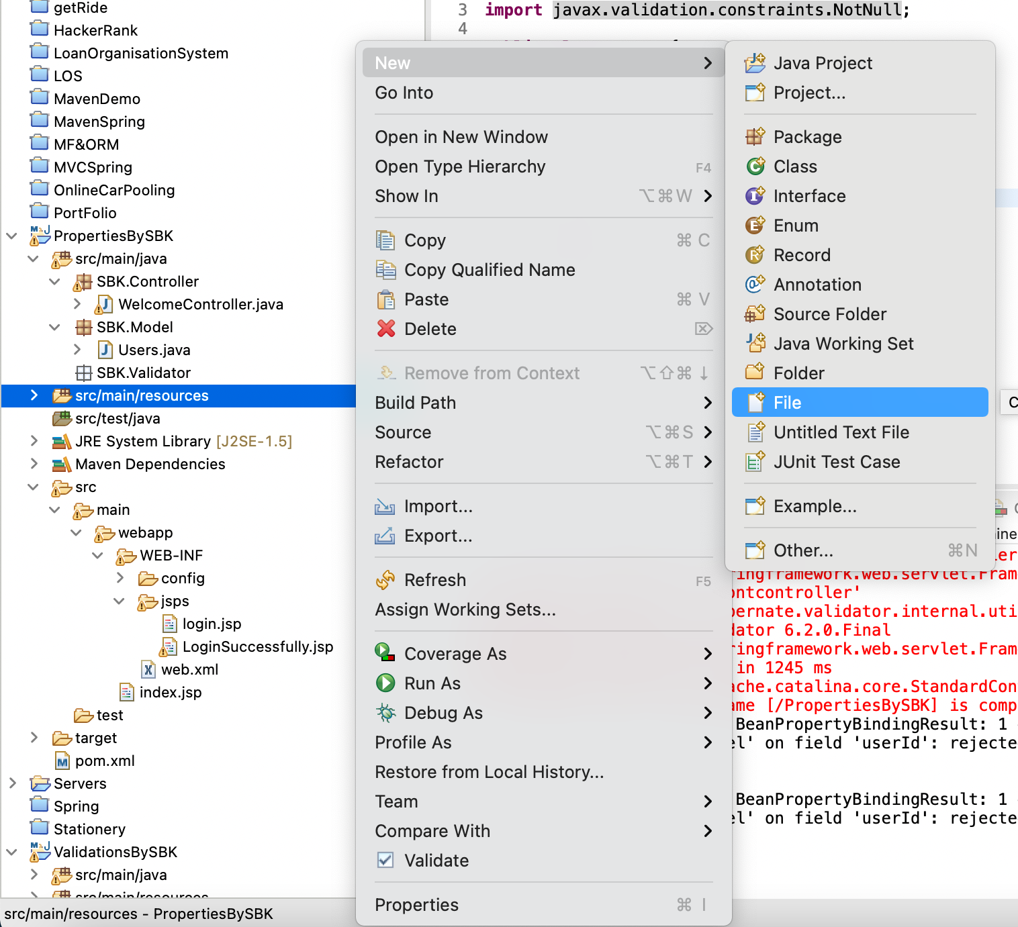
Step1: Create the messages.properties
Create a file and named it as messages.properties under the src/main/resources

Slide 6
Step2: Override the Default Messages
We can override the default messages using key as <Annotation>.<modelObject>.<attributeName> and value is the message to be displayed for that particular error.
Eg .
NotNull.userModel.userId = #SBK User Name Can't Be Empty
→For the Custom Validator Annotation Also we can override the error message
Password.userModel.pwd = #SBK Password Should be Matched

Slide 7
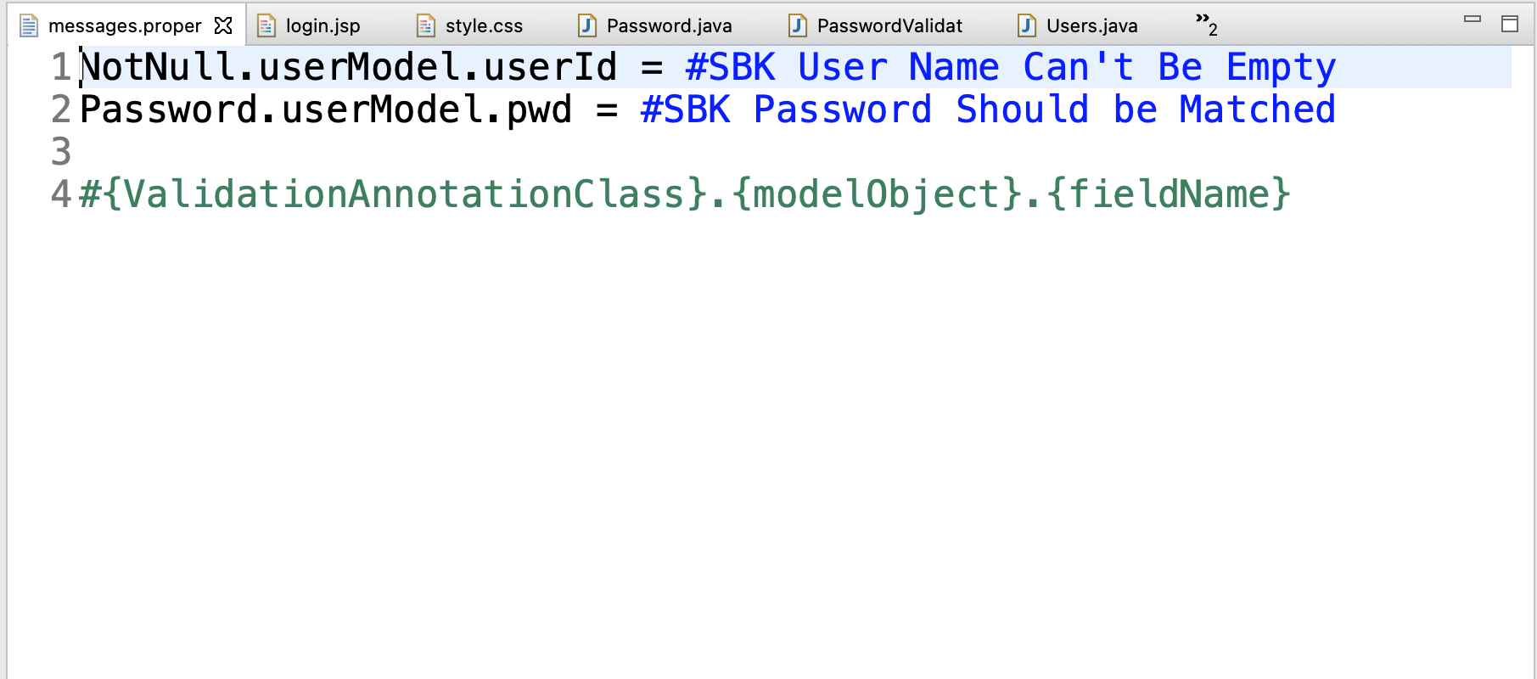
Step2: Override the Default Messages

Slide 8
Step3: To Load messages.properties
We have to create Bean for this in our spring.xml file
<bean
class =“org.springframework.context.support.ResourceBundleMessageSource”
id = “messageSource”>
<property name = "basename" value = "messages" />
</bean>

Slide 9
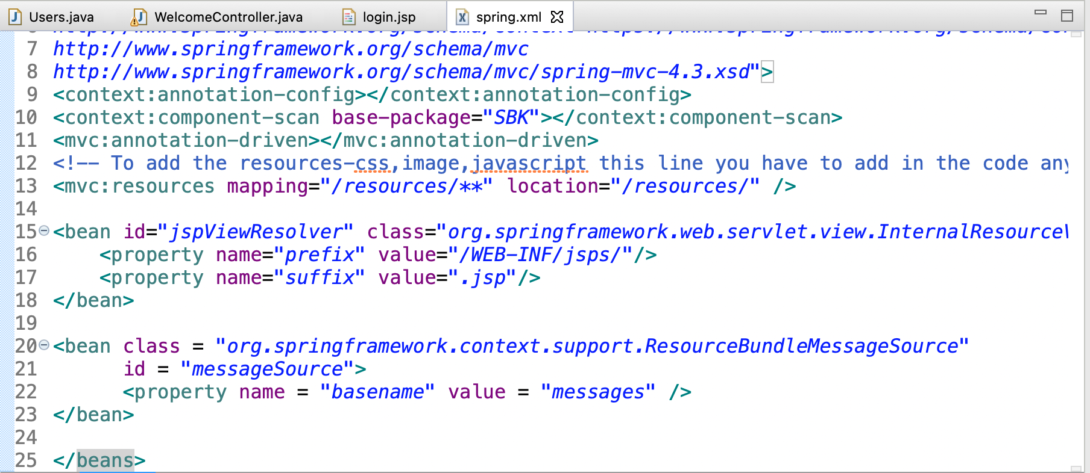
Step3: To Load messages.properties

Slide 10
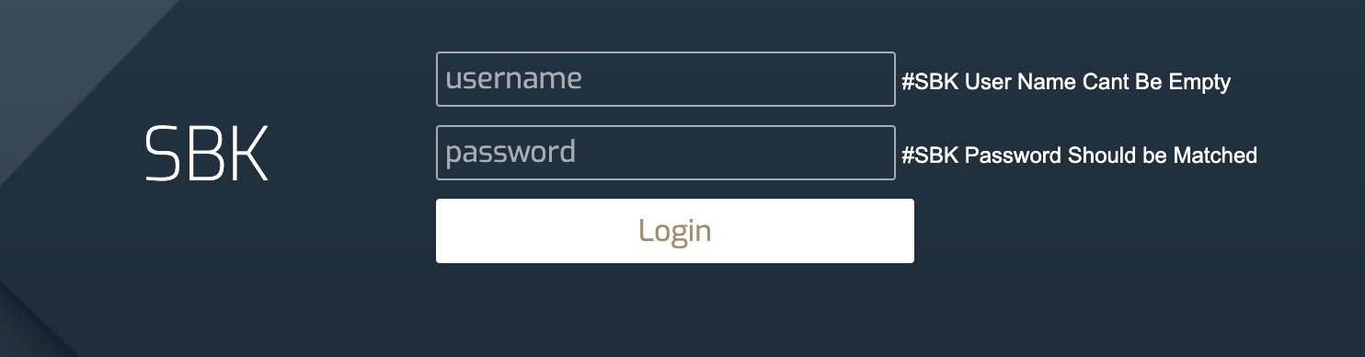
OUTPUT

Slide 11
THANK YOU
Github link for project reference: https://github.com/chiragsardana/Question-In-Java/tree/master/MF%26ORM/PropertiesBySBK

